Slide 1

WHITE NOISE ANALYSIS OF NEURAL NETWORKS
Cemile SeneM ARABACI

Slide 2


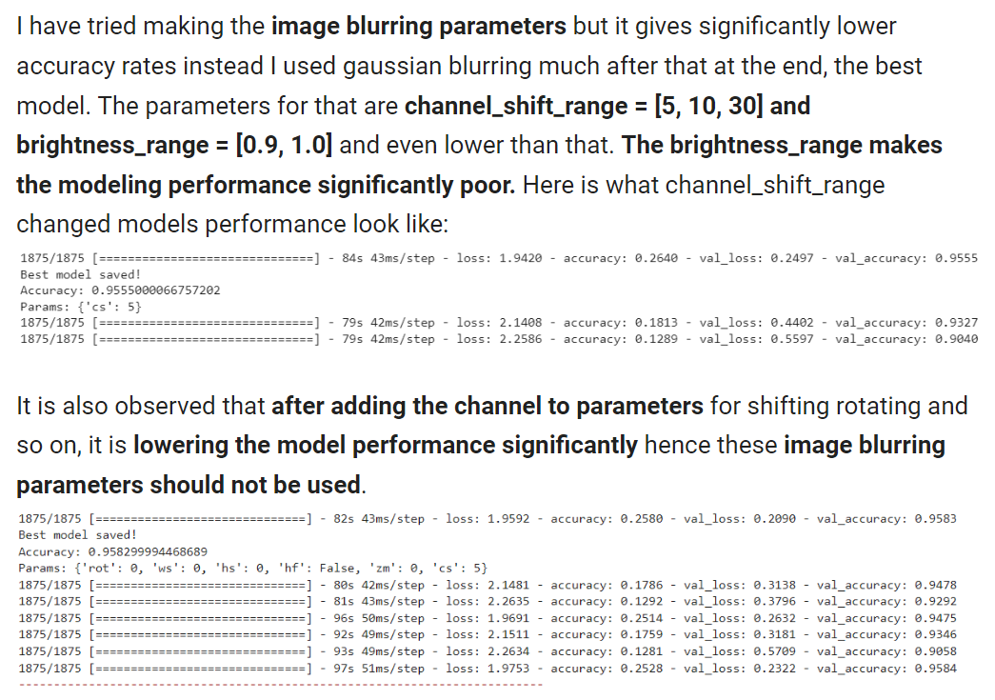
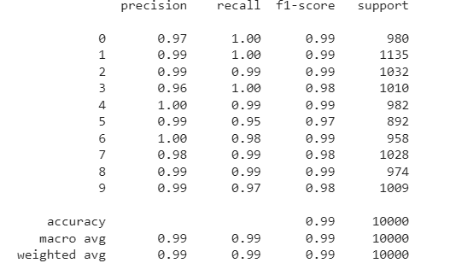
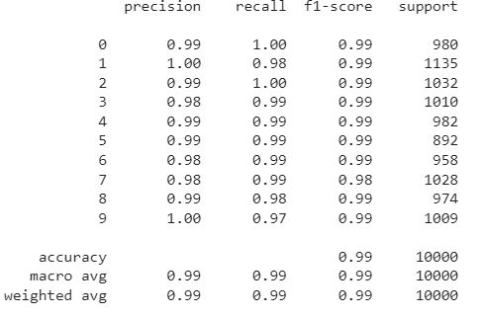


TRAINING IMAGE AUGMENTATION
MNIST Dataset
Found the best model performance by applying width, and height shift, zooming parameters, and Gaussian blurring
Without transformations
With transformations
On noisy MNIST testing images

Slide 3
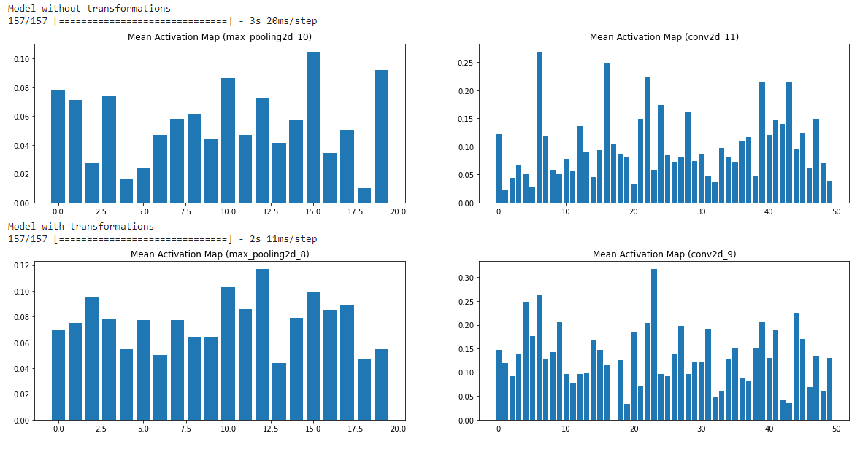
CONVOLUTIONAL LAYERS WITH TRANSFORMATION HAS HIGHER ACTIVATIONS
conv2d
Activation percentages
Filter counts
conv2d
Filter counts

Slide 4
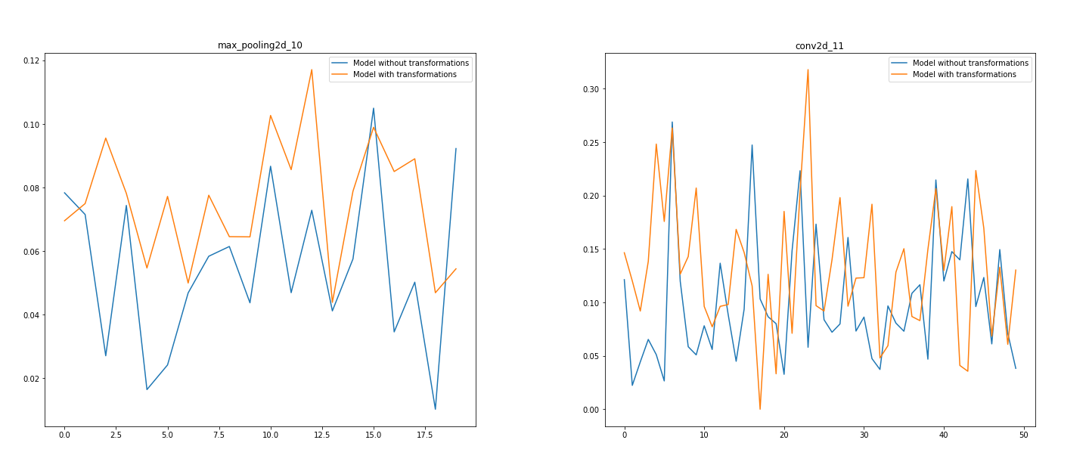
conv2d
Activation percentages
Filter counts

Slide 5

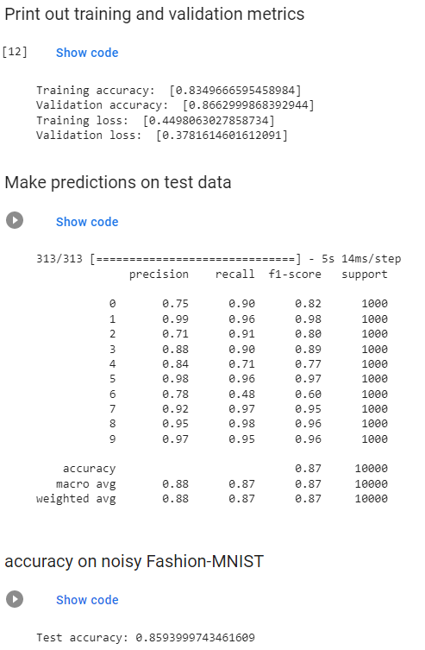
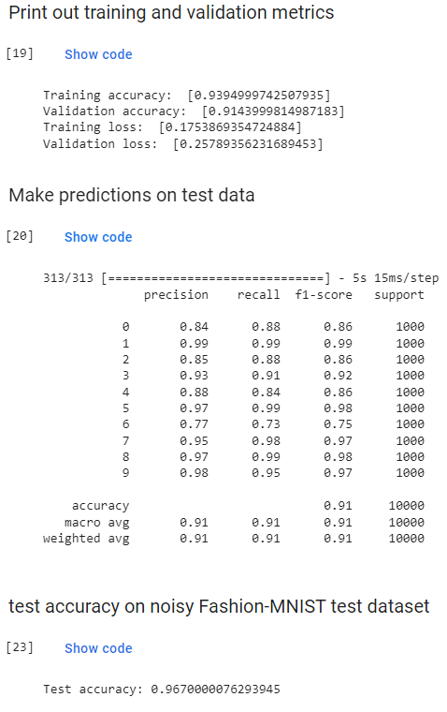
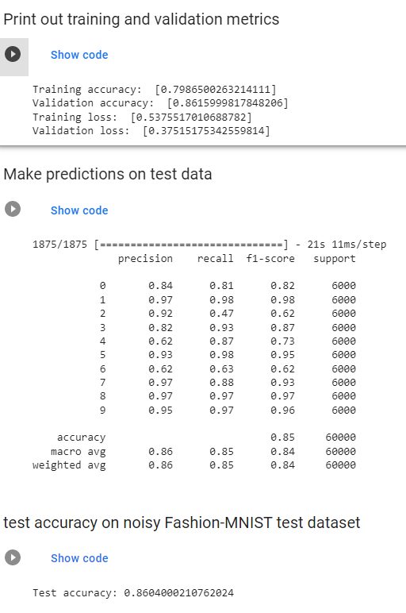
Fashion-MNIST Dataset
Found the best model performance by applying rotation, width and height shift, zoom, rotation, shear, horizontal flip parameters, and Gaussian blurring
2. choice red-boxed model is learning through each independent parameter running and reflects on that in the next parameter training.
With transformation sets
With one transformation set

Slide 6
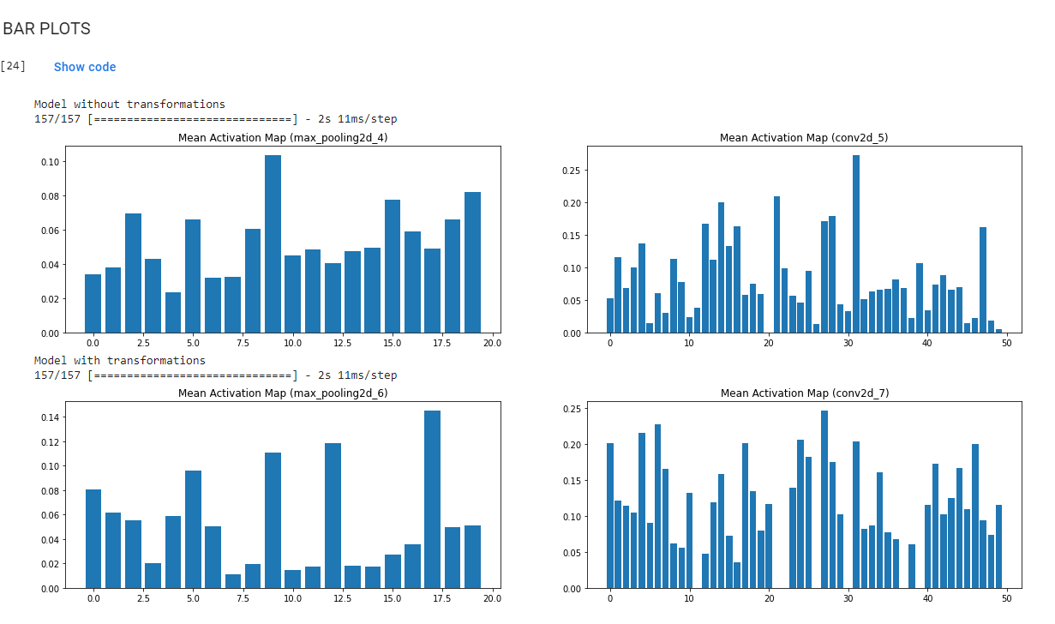
CONVOLUTIONAL LAYERS WITH TRANSFORMATION HAS HIGHER ACTIVATIONS
conv2d
Activation percentages
Filter counts
conv2d
Filter counts

Slide 7
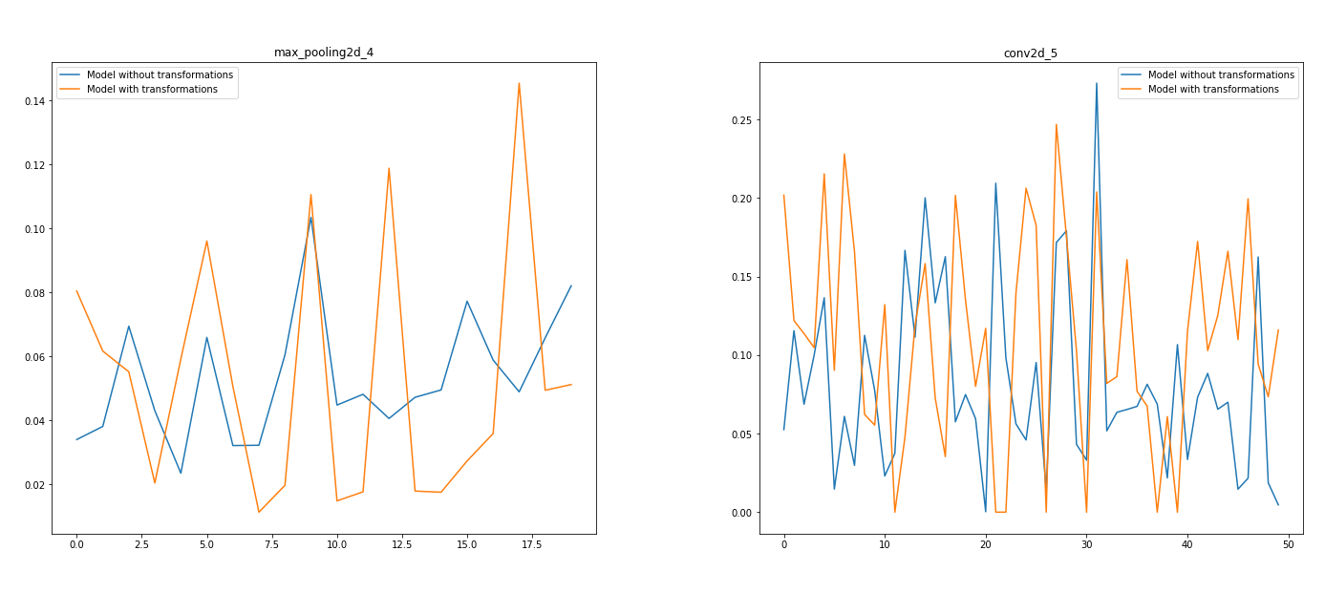
conv2d
Activation percentages
Filter counts

